Slide 1



Forest Fire Detection Using Deep Learning - AI
Name:- Ankush Uday Naik
Student ID:-STU6736199e275a71731598750

Slide 2

Learning Objectives
Apply Python programming to implement AI-based solutions.
Understand and utilize Deep Learning techniques for image classification.
Design and train a Convolutional Neural Network (CNN) for detecting forest fires.
Perform data preprocessing tasks such as resizing, normalization, and augmentation.
Evaluate the model using metrics like accuracy, loss, and confusion matrix.
Analyze results and identify improvements for better model performance.
GOAL
Source :
www.freepik.com/

Slide 3





Tools and Technology used
Programming Language: Python
Development Environment: Google Colab
Dataset Source: Kaggle (elmadafri/the-wildfire-dataset)
Deep Learning Framework: TensorFlow / Keras
Libraries Used: NumPy, Matplotlib
Preprocessing: Keras ImageDataGenerator
Model Type: Convolutional Neural Network (CNN)
Code Management & Sharing: GitHub

Slide 4
Methodology
Data Collection: Acquired a labeled dataset of fire and non-fire images.
Data Preprocessing: Resized, normalized, and augmented images for training.
Model Building: Designed a CNN architecture to extract features and classify images.
Training: Trained the model using training data with validation monitoring.
Evaluation: Tested the model's accuracy and performance using test data.
Deployment (Optional): Model ready for integration into real-time detection systems.

Slide 5
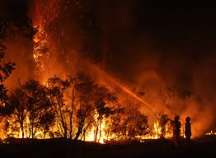
Problem Statement:
Forest fires pose a serious threat to biodiversity, human life, and property. Detecting fires early is crucial but often delayed due to human limitations or lack of surveillance. A smart automated system is needed to detect fires in real-time to reduce response time and minimize losses.

Slide 6
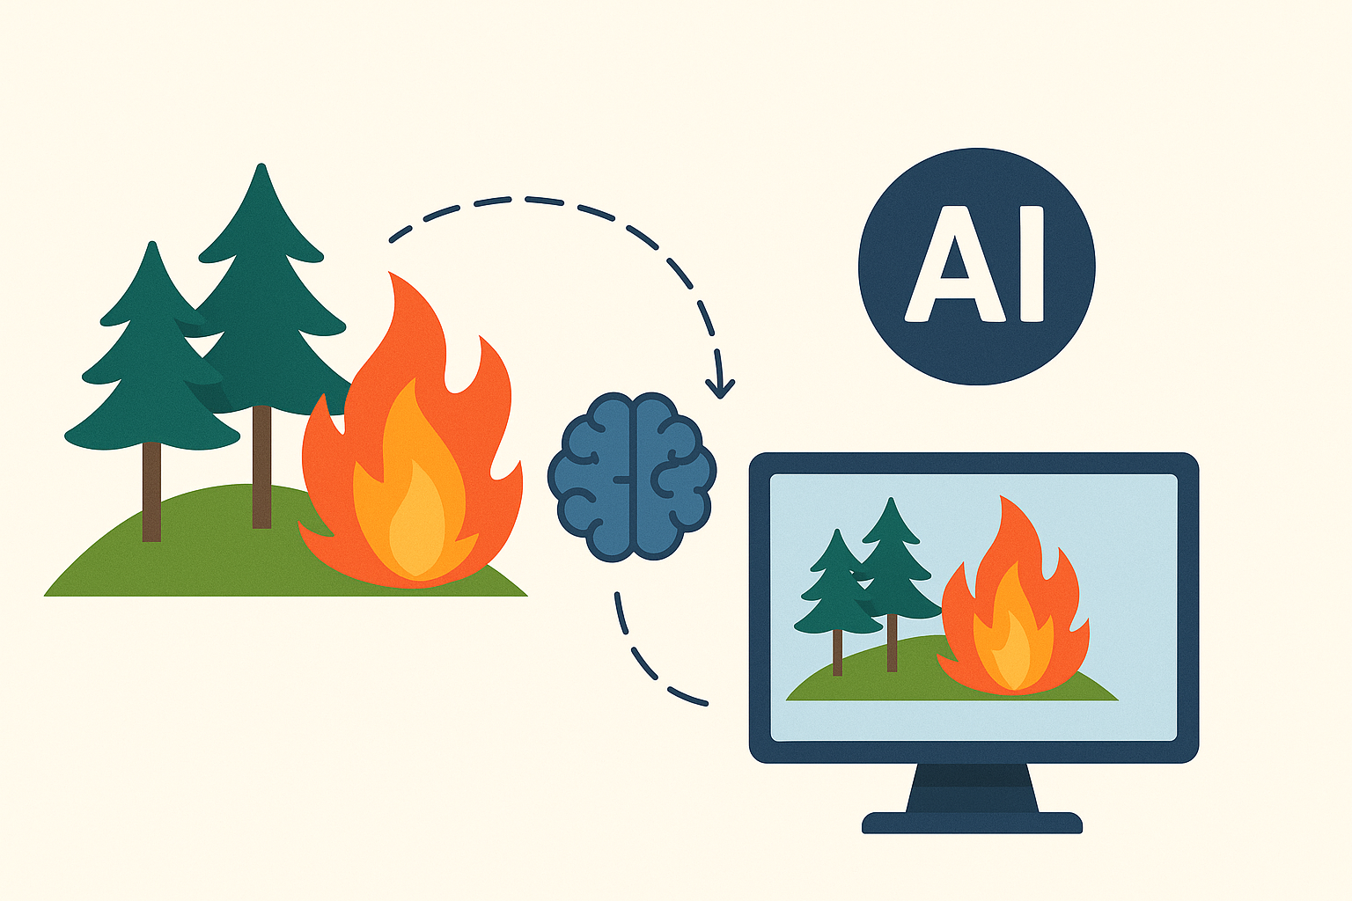
Solution:
Our solution is an AI-powered system that:
Analyzes images using a trained CNN model.
Distinguishes between fire and non-fire scenarios.
Provides accurate detection to aid quick emergency responses.
This system improves accuracy and efficiency over traditional methods.

Slide 7
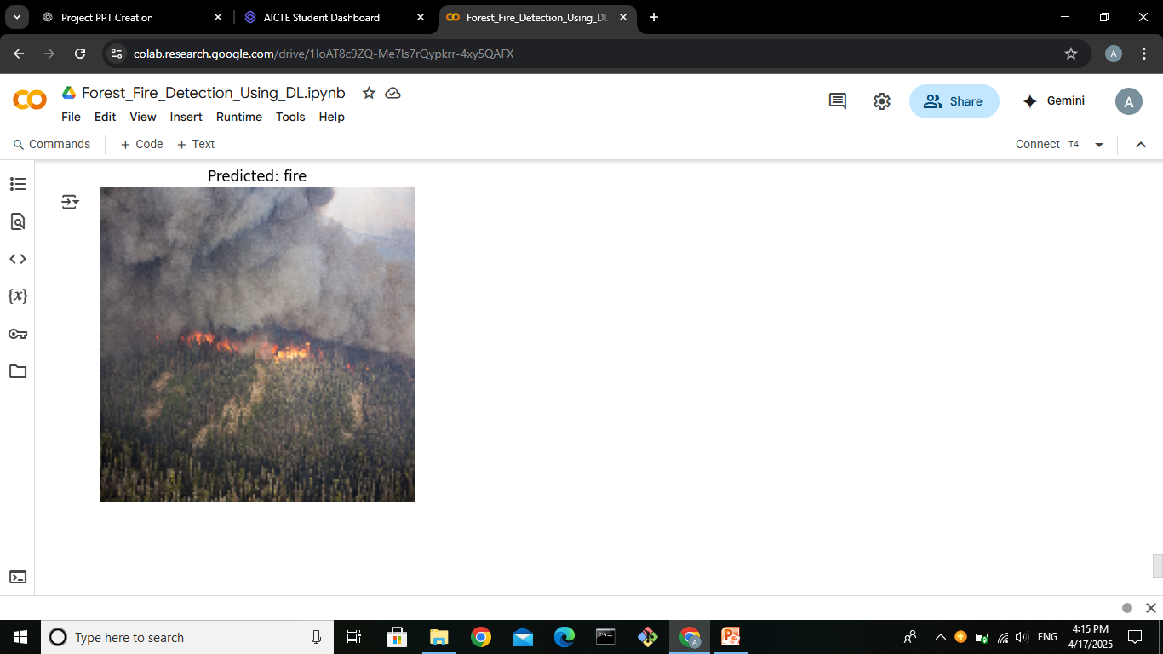
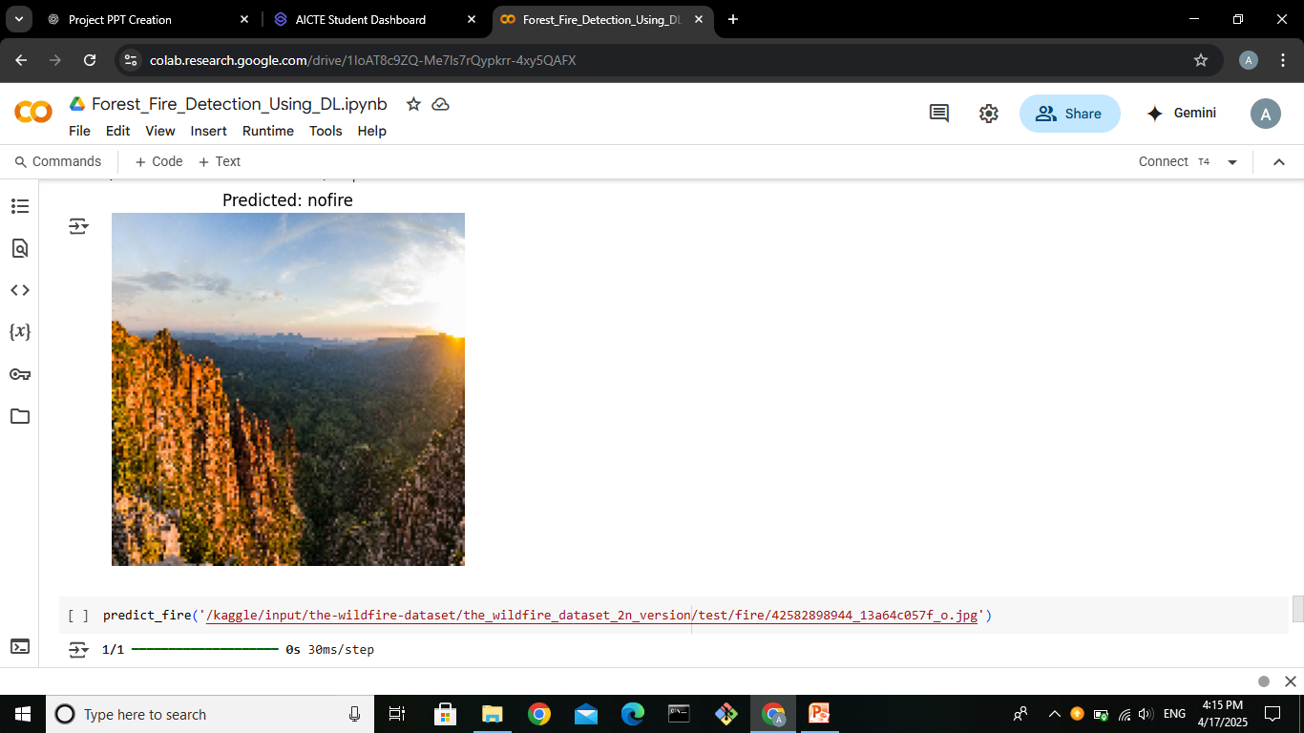
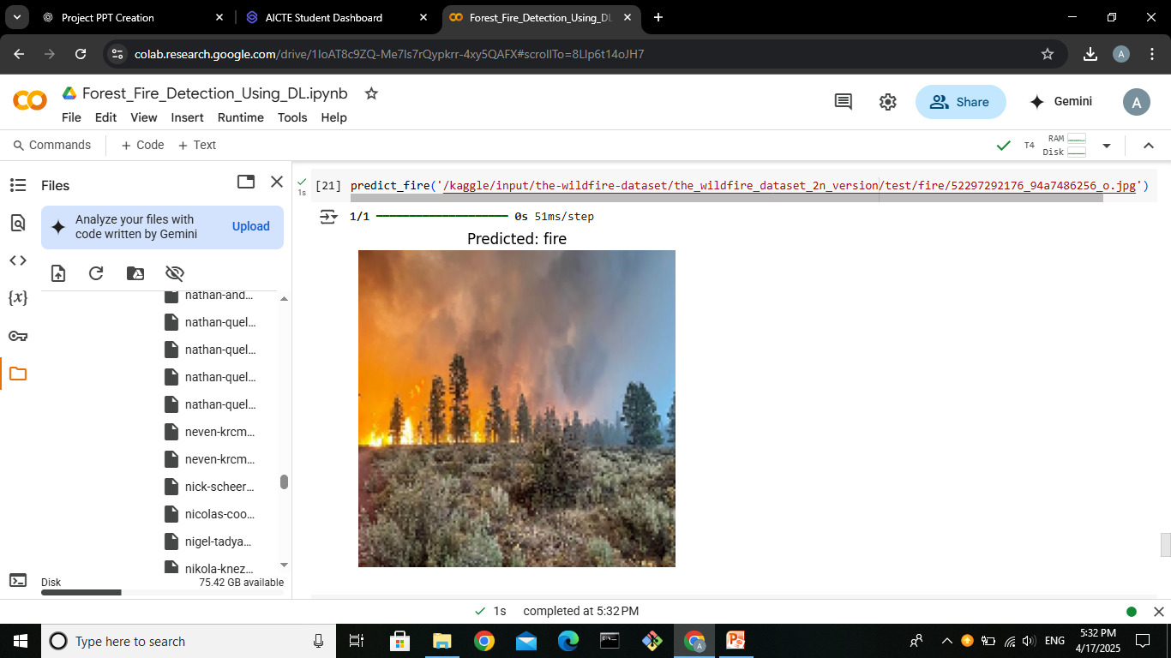
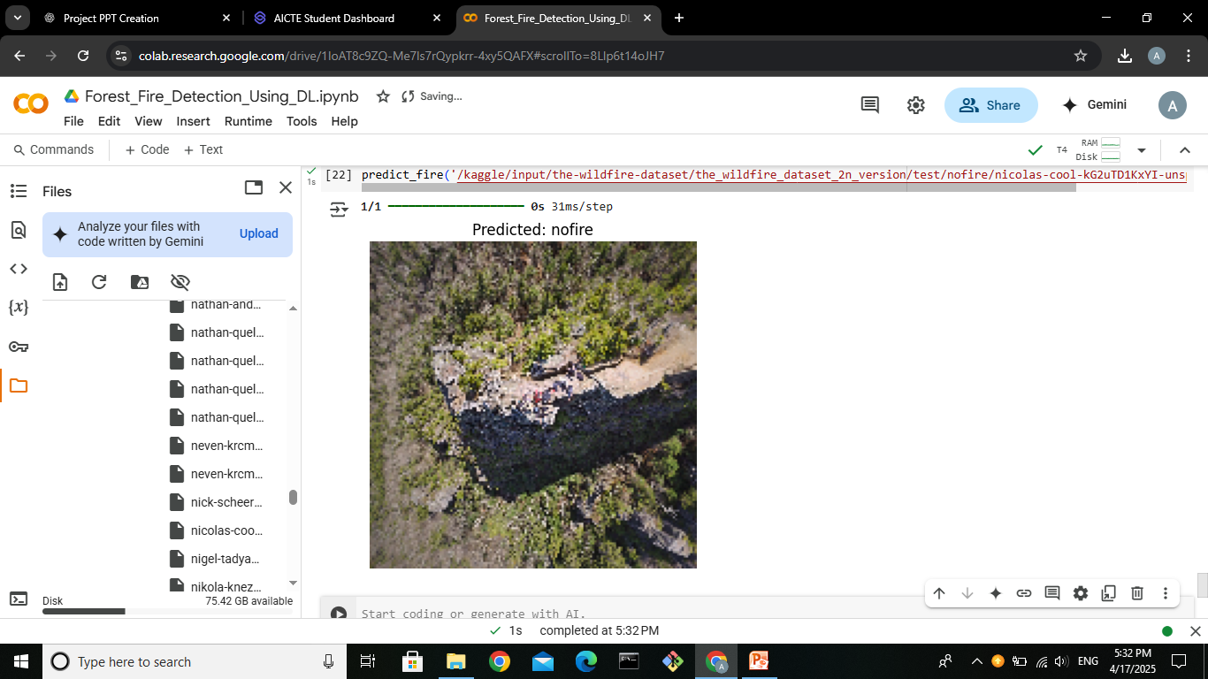
Screenshot of Output:

Slide 8
Conclusion:
Successfully developed a deep learning model to detect forest fires using image data.
Achieved accurate classification between fire and non-fire images using a CNN.
Demonstrated how AI can play a crucial role in early wildfire detection and disaster management.
The system provides a strong foundation for integration into real-time monitoring solutions.
Future work may include drone integration, real-time camera feeds, expanding the dataset, improving model generalization, and deploying the model via edge devices or cloud platforms.
🔗 GitHub Link : https://github.com/Ankush703-web/AICTE_internship_2025_AI_Green_Technology.git

